Slide 1
Camera calibration and single view metrology
Class 4
Read Zhang’s paper on calibration
http://www.vision.caltech.edu/bouguetj/calib_doc/papers/zhan99.pdf
Read Criminisi’s paper on single view metrology
http://www.unc.edu/courses/2004fall/comp/290/089/papers/Criminisi99.pdf

Slide 2
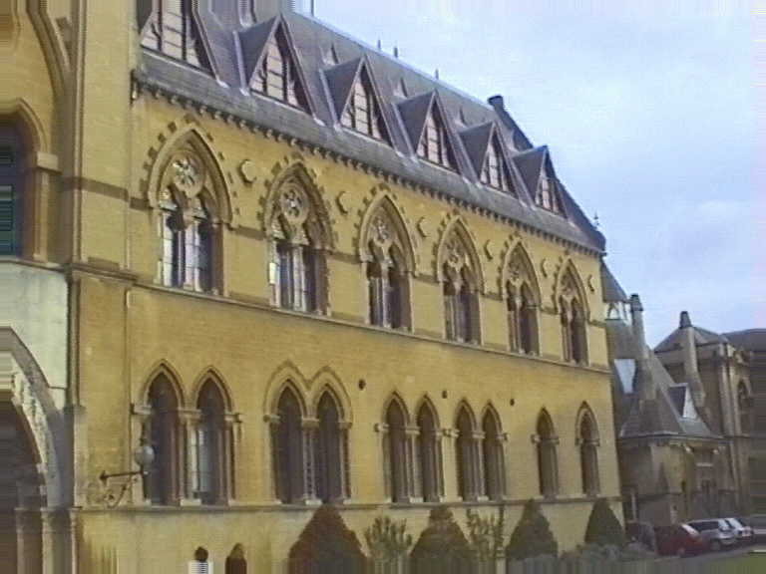
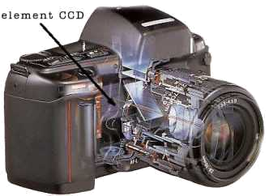
Camera model
Relation between pixels and rays in space
?

Slide 3
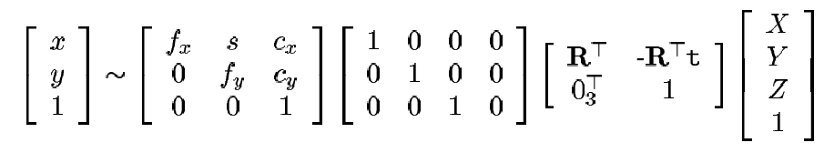
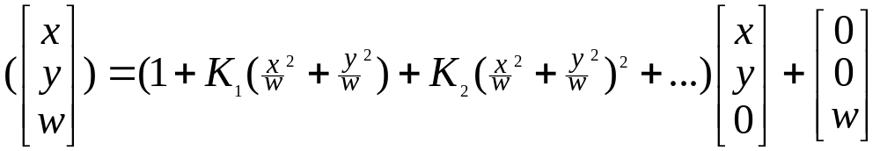
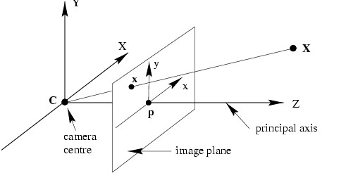
Camera model
Perspective camera model with radial distortion:
R
R

Slide 4
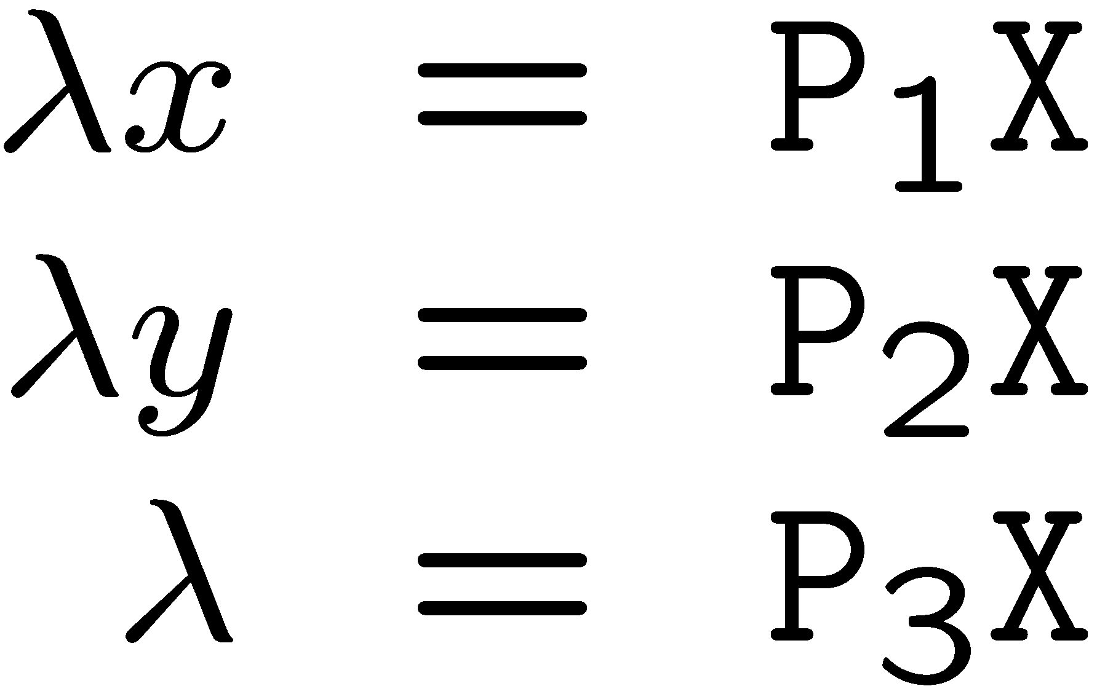
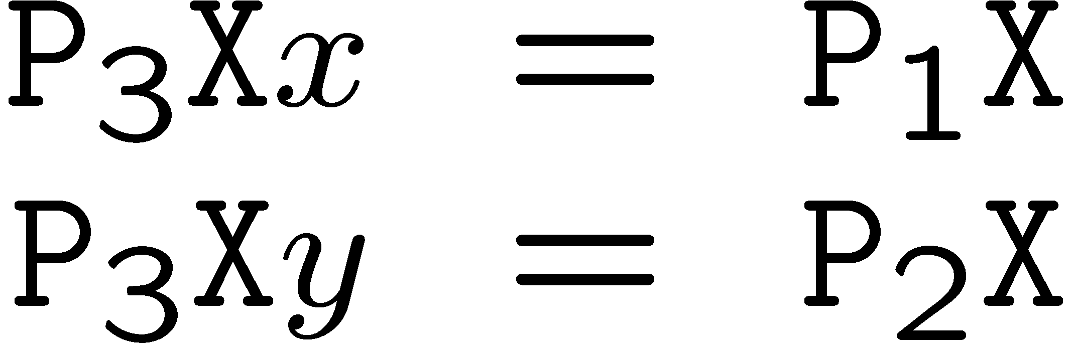
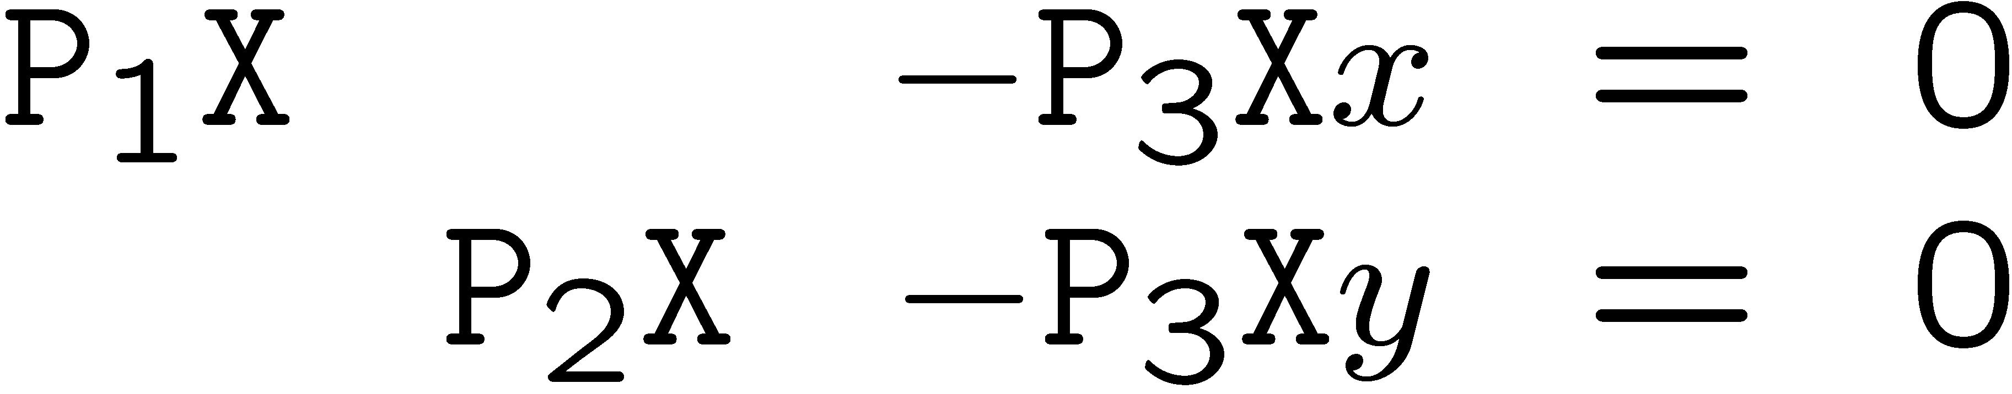
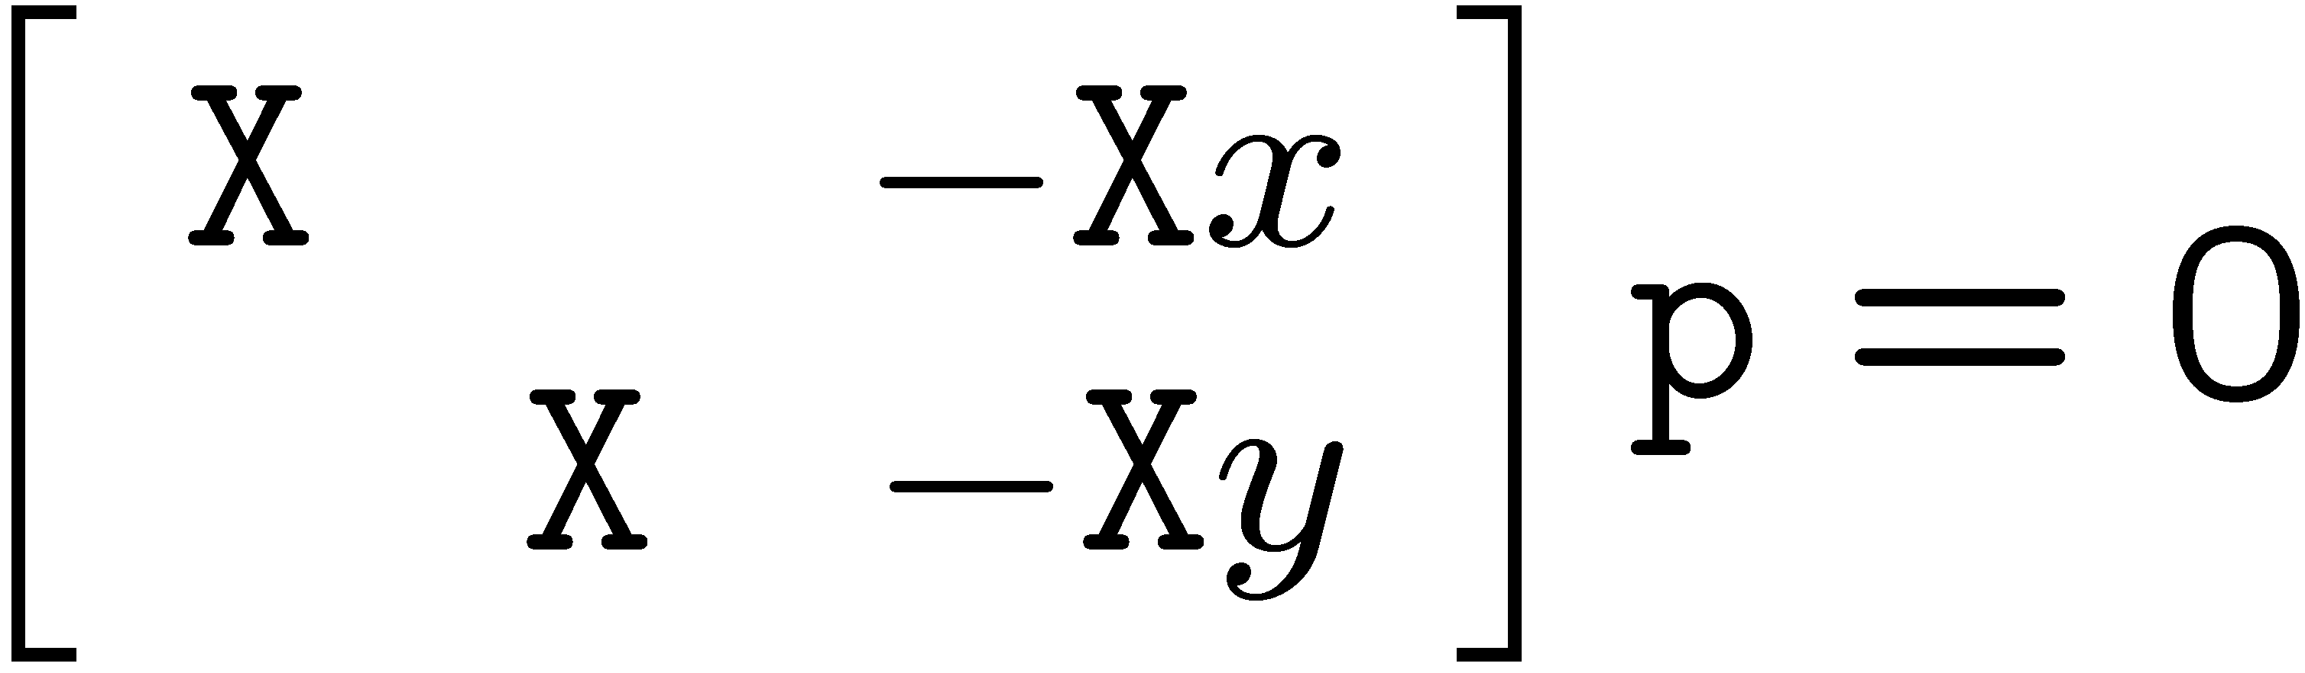
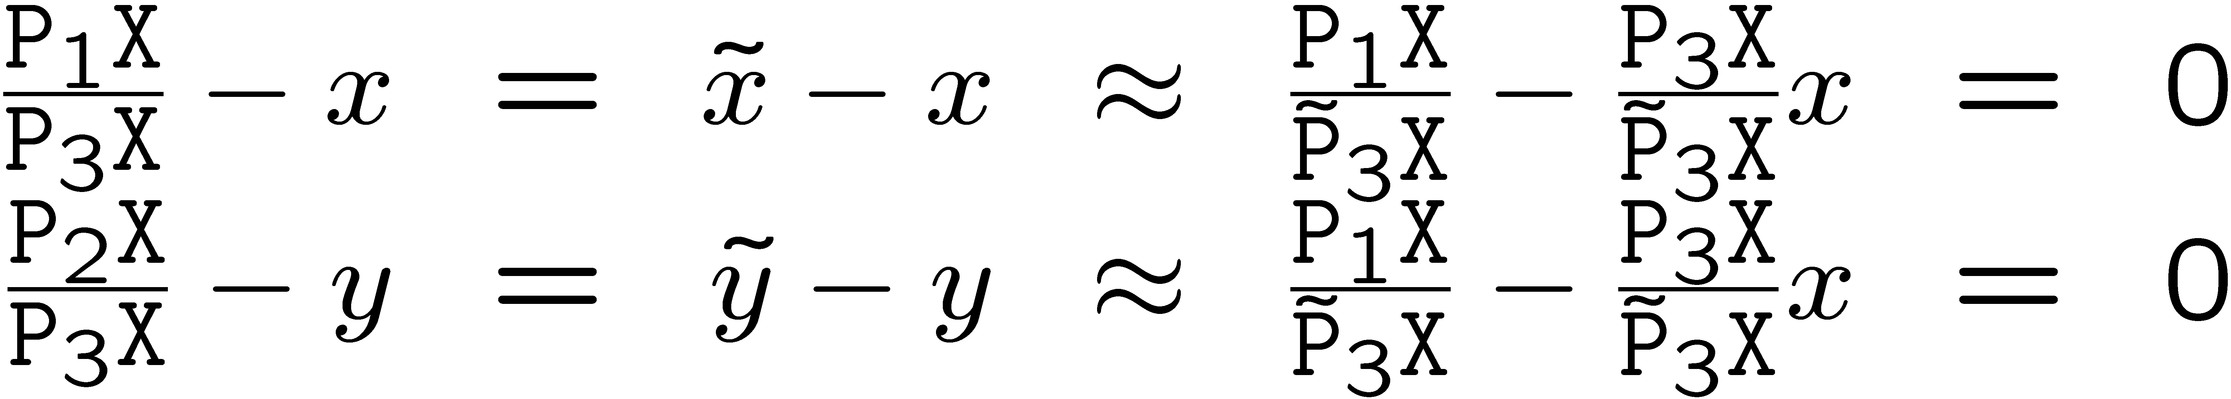
DLT alternative derivation
projection equations:
eliminate λ:
projection equations:
equation for iterative algorithm:

Slide 5
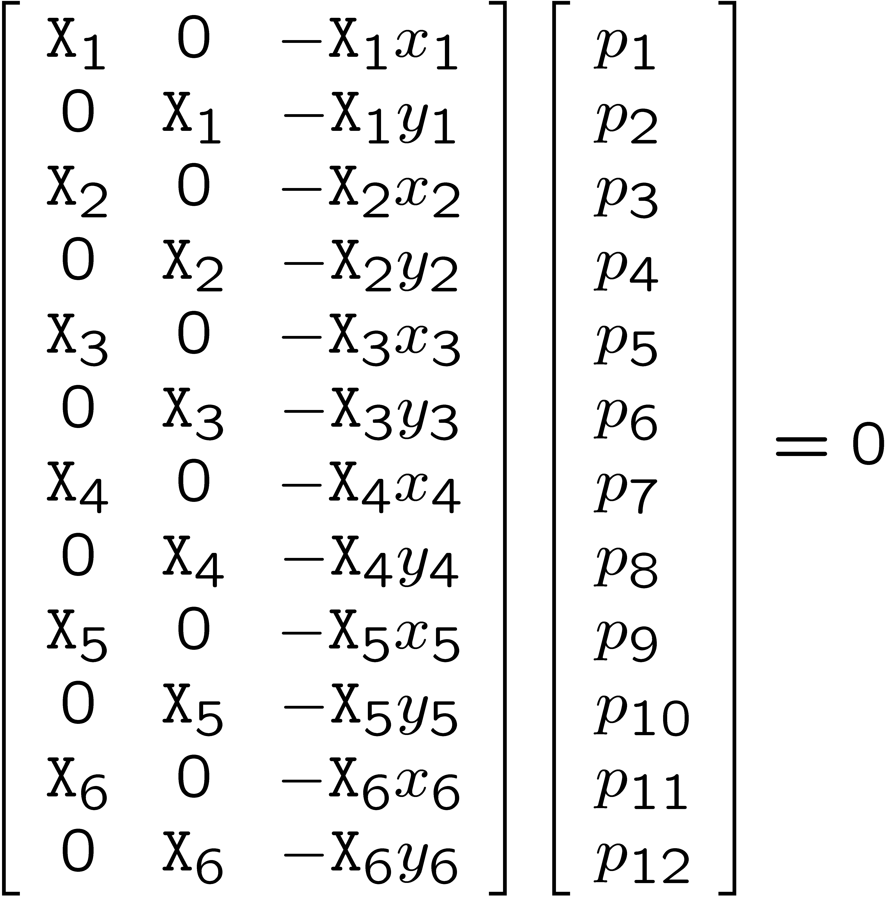
DLT alternative derivation

Slide 6
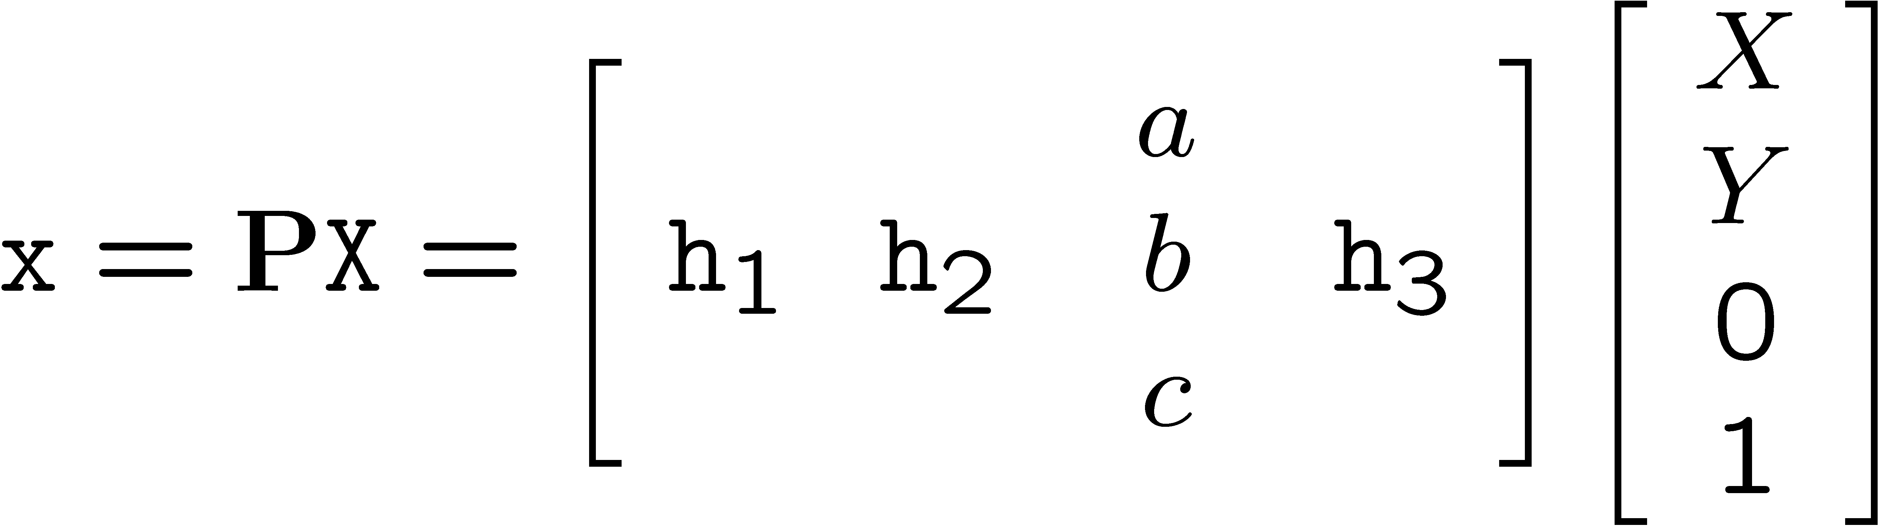
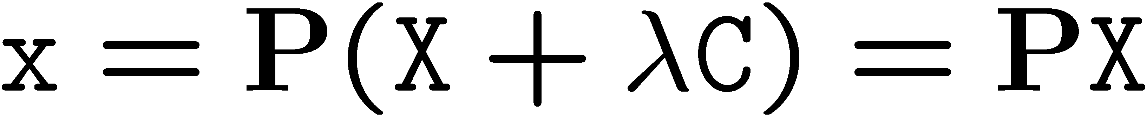
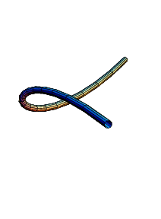
Degenerate configurations
  Points lie on plane and/or single line passing through projection center
  Camera and points on a twisted cubic

Slide 7




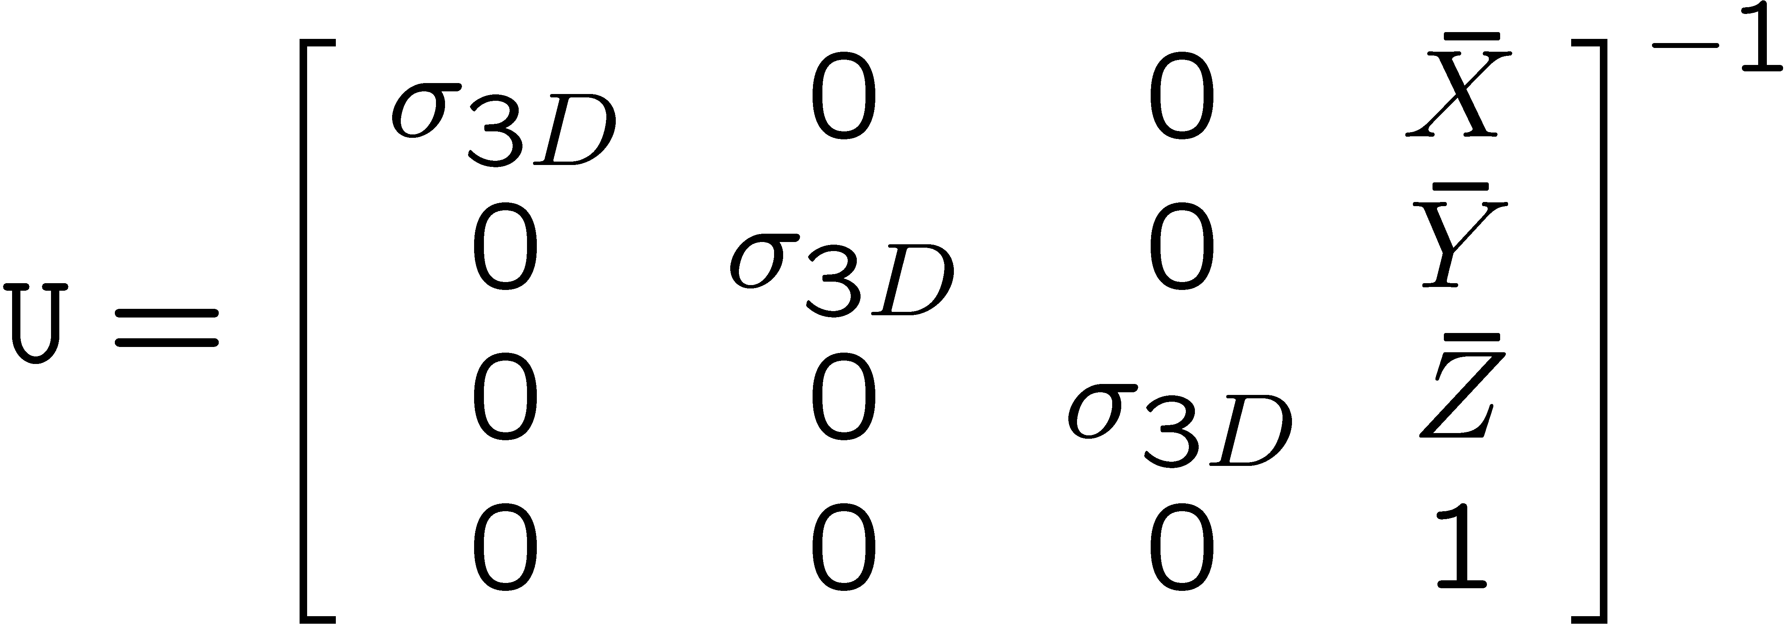
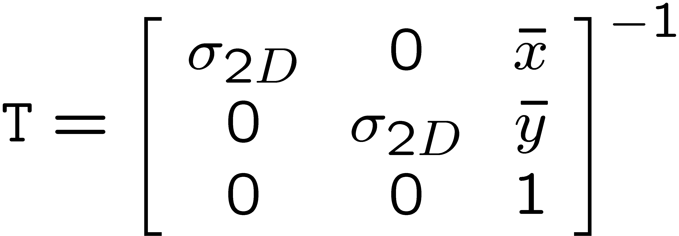
Data normalization
Scale data to values of order 1
move center of mass to origin
scale to yield order 1 values

Slide 8
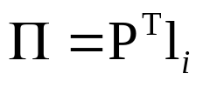
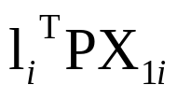
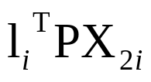
Line correspondences
Extend DLT to lines
(back-project line)
(2 independent eq.)

Slide 9
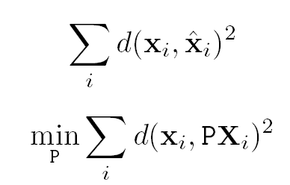
Geometric error

Slide 10


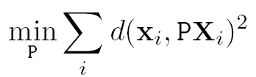

Gold Standard algorithm
Objective
Given n≥6 2D to 2D point correspondences {X_{i}↔x_{i}’}, determine the Maximum Likelyhood Estimation of P
Algorithm
Linear solution:
  Normalization:
  DLT
Minimization of geometric error: using the linear estimate as a starting point minimize the geometric error:
Denormalization:
~
~
~

Slide 11
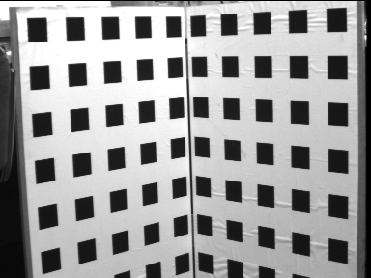
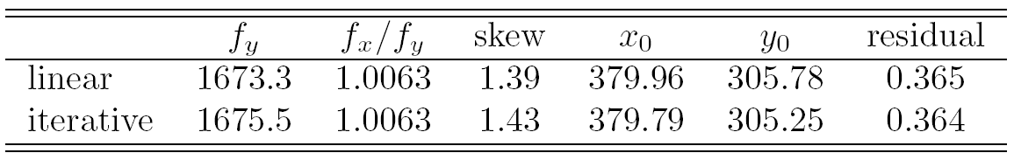
Calibration example
Canny edge detection
Straight line fitting to the detected edges
Intersecting the lines to obtain the images corners
typically precision <1/10
(H&Z rule of thumb: 5n constraints for n unknowns)

Slide 12

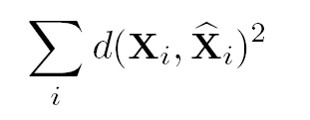
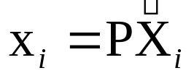
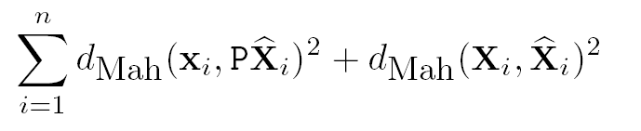

Errors in the image
(standard case)
Errors in the world
Errors in the image and in the world

Slide 13
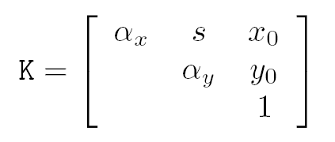
Restricted camera estimation
Find best fit that satisfies
skew s is zero
pixels are square
principal point is known
Minimize geometric error
impose constraint through parametrization
Minimize algebraic error
assume map from param q → P=K[R|-RC], i.e. p=g(q)
minimize ||Ag(q)||

Slide 14
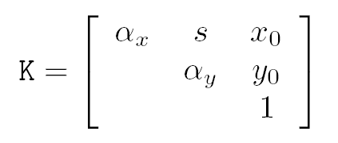
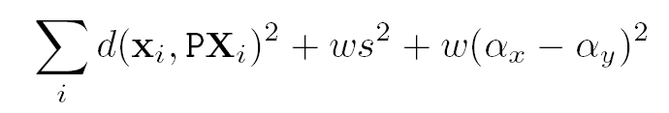
Restricted camera estimation
Initialization
Use general DLT
Clamp values to desired values, e.g. s=0, α_{x}= α_{y}
Note: can sometimes cause big jump in error
Alternative initialization
Use general DLT
Impose soft constraints
gradually increase weights
Note: doesn’t help to deal with planar degeneracy

Slide 15
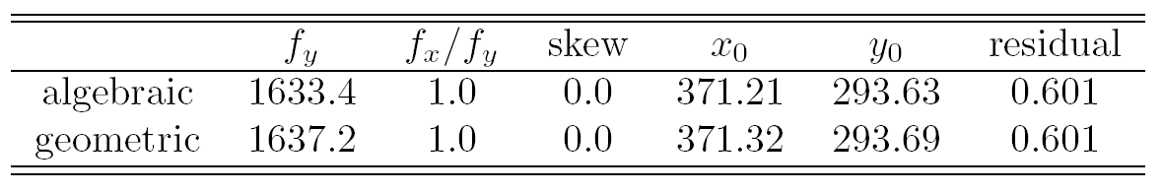

Slide 16

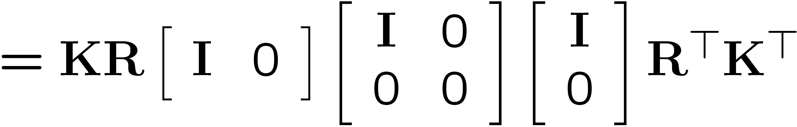

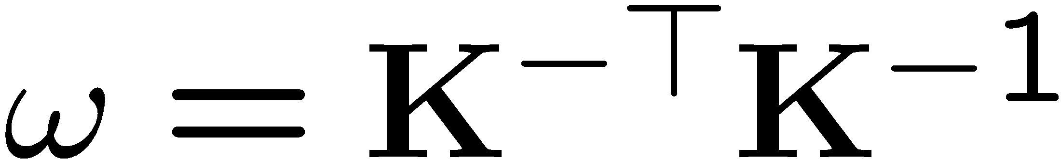
Image of absolute conic
Image of absolute conic is related to camera intrinsics
Useful for calibration and self-calibration

Slide 17
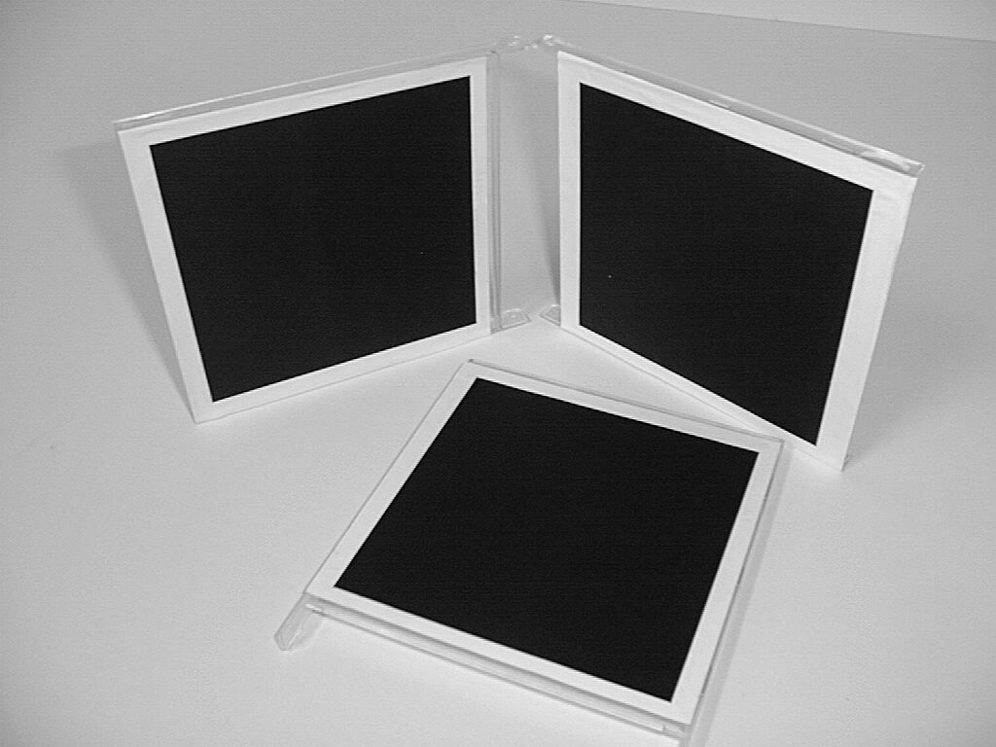
A simple calibration device
compute H for each square
(corners  (0,0),(1,0),(0,1),(1,1))
compute the imaged circular points H(1,±i,0)^{T}
fit a conic to 6 circular points
compute K from ω through cholesky factorization
(≈ Zhang’s calibration method)

Slide 18
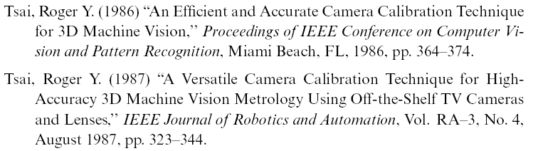
Some typical calibration algorithms
Tsai calibration
Reg Willson’s implementation:
http://www-2.cs.cmu.edu/~rgw/TsaiCode.html
Zhangs calibration
Z. Zhang. A flexible new technique for camera calibration. IEEE Transactions on Pattern Analysis and Machine Intelligence, 22(11):1330-1334, 2000.
Z. Zhang. Flexible Camera Calibration By Viewing a Plane From Unknown Orientations. International Conference on Computer Vision (ICCV'99), Corfu, Greece, pages 666-673, September 1999.
http://research.microsoft.com/~zhang/calib/
Jean-Yves Bouguet’s matlab implementation:
http://www.vision.caltech.edu/bouguetj/calib_doc/

Slide 19
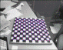
Assignment 1
(due by next Tuesday before class)
Find a camera
Calibration approach 1
  Build/use calibration grid (2 orthogonal planes)
  Perform calibration using (a) DLT and (b) complete gold standard algorithm (assume error only in images, model radial distortion, ok to click points by hand)
Calibration approach 2
  Build/use planar calibration pattern
  Use Bouguet’s matlab calibration toolbox (≈Zhang’s approach)
    http://www.vision.caltech.edu/bouguetj/calib_doc/
  (or implement it yourself for extra points)
Compare results of approach 1(a),1(b) and 2
Make short report of findings and be ready to discuss in class

Slide 20
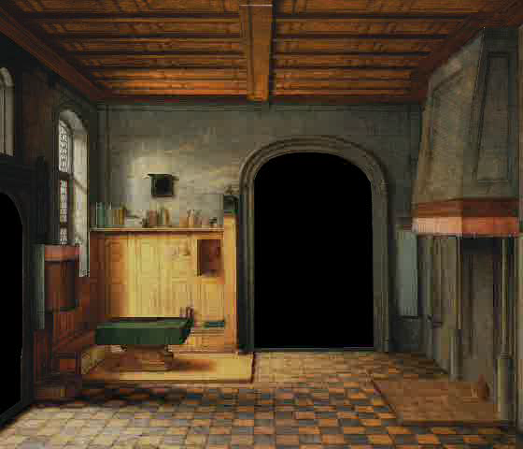
Single View Metrology
courtesy of Antonio Criminisi

Slide 21



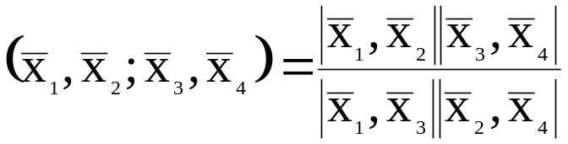
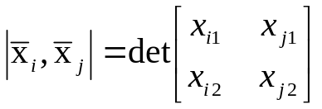
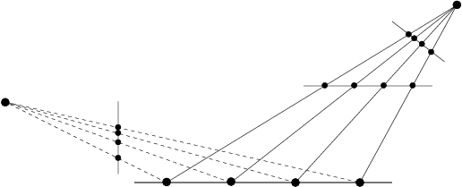
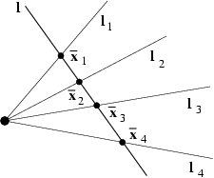
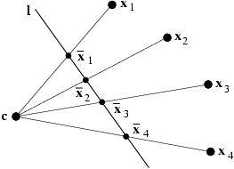
Background: Projective geometry of 1D
3DOF (2x2-1)
The cross ratio
Invariant under projective transformations

Slide 22
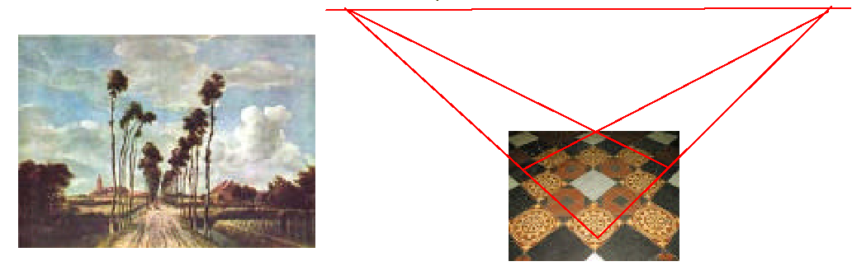
Vanishing points
Under perspective projection points at infinity can have a finite image
The projection of 3D parallel lines intersect at vanishing points in the image

Slide 23
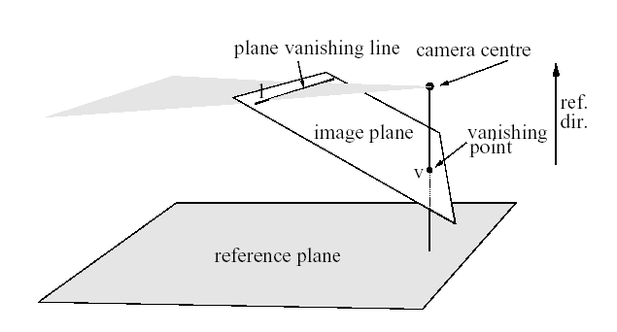
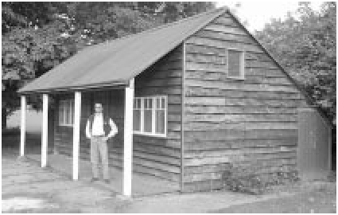
Basic geometry

Slide 24
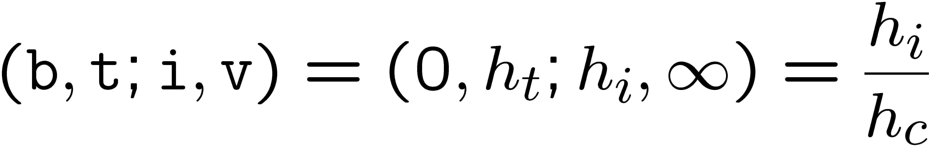
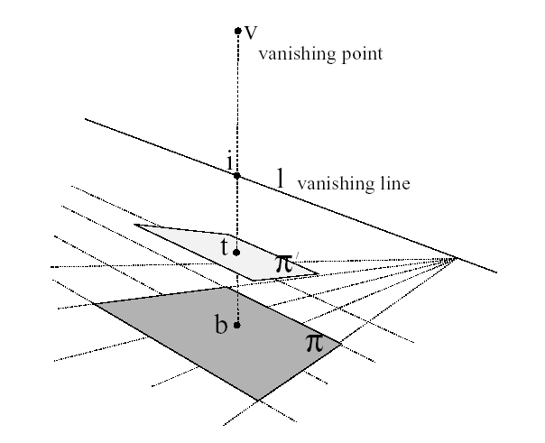
Basic geometry
Allows to relate height of point to height of camera

Slide 25
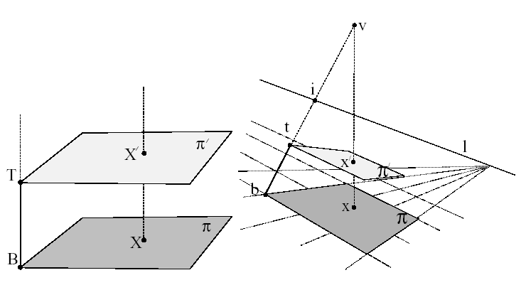
Homology mapping between parallel planes
Allows to transfer point from one plane to another

Slide 26
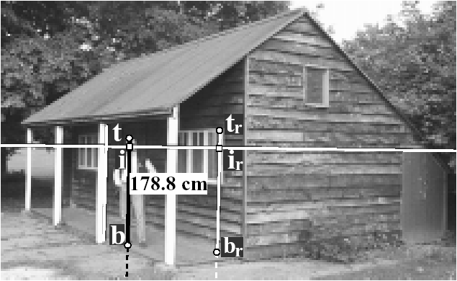
Single view measurements

Slide 27
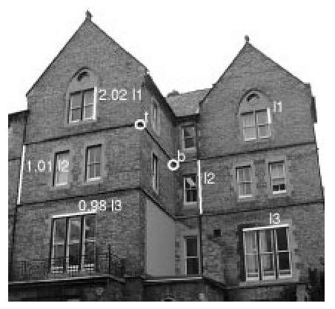
Single view measurements

Slide 28
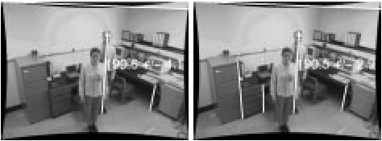


Forensic applications
190.6±4.1 cm
190.6±2.9 cm
A. Criminisi, I. Reid, and A. Zisserman.
Computing 3D euclidean distance from a single view.
Technical Report OUEL 2158/98, Dept. Eng. Science, University of Oxford, 1998.

Slide 29


La Flagellazione di Cristo (1460)
Galleria Nazionale delle Marche by Piero della Francesca (1416-1492)
http://www.robots.ox.ac.uk/~vgg/projects/SingleView/

Slide 30

Next class
Feature tracking and matching

